Slide 1
Pre-Calc & Trig
Day 48

Slide 2

Bell Work
In quadrilateral PQRS below,
sides PS and QR are parallel for what value of x ?
Individual Question
182
132
112
110
70

Slide 3
From Last Time
Pg 402 #7-13 (odd), 37-40

Slide 4
5.5 Multiple Angle and Product-To-Sum Formulas
Objective: Use formulas to rewrite and evaluate trig functions

Slide 5

Double-Angle Formulas [page 405]
$\sin{2u}=2 sin u\cos{u}$
$\cos{2u}=\cos^{2}u− \sin^{2}u→2\cos^{2}u−1→1−2\sin^{2}u$
$$\tan{2u=\frac{2 tan u}{1−tan^{2}u}}$$

Slide 6
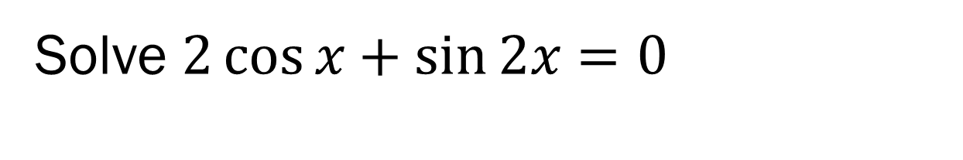
Example 1 (Solving Multiple Angle)
Solve $2\cos{x+\sin{2x=0}}$

Slide 7
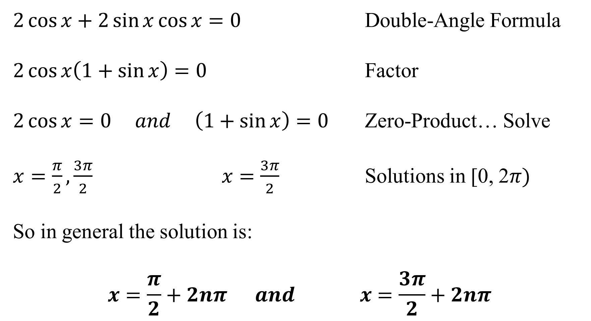
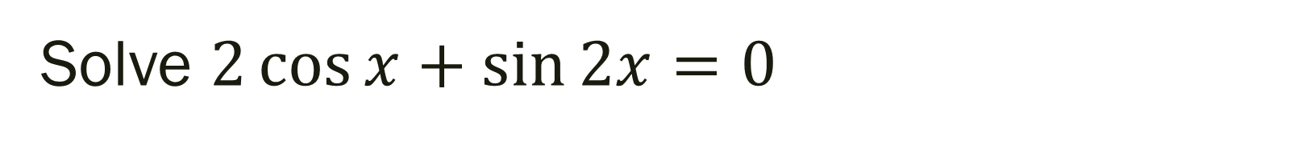
Solve $2\cos{x+\sin{2x=0}}$
$2\cos{x+2\sin{x}\cos{x=0}}$ Double-Angle Formula
$2\cos{x\left(1+\sin{x}\right)=0}$ Factor
$2\cos{x=0 and \left(1+\sin{x}\right)=0}$ Zero-Product… Solve
$x=\frac{π}{2}, \frac{3π}{2} x=\frac{3π}{2}$ Solutions in [0, 2$π)$
So in general the solution is:
$$x=\frac{π}{2}+2nπ and x=\frac{3π}{2}+2nπ$$

Slide 8

Power-Reducing Formulas [page 407]
$\sin^{2}u=\frac{1−\cos{2u}}{2}$
$$\cos^{2}u=\frac{1+\cos{2u}}{2}$$
$$\tan^{2}u=\frac{1−\cos{2u}}{1+\cos{2u}}$$

Slide 9

Example 2 (Power Reducing Formulas)
Rewrite $\sin^{4}x$ as a sum of first powers of cosines of multiple angles

Slide 10
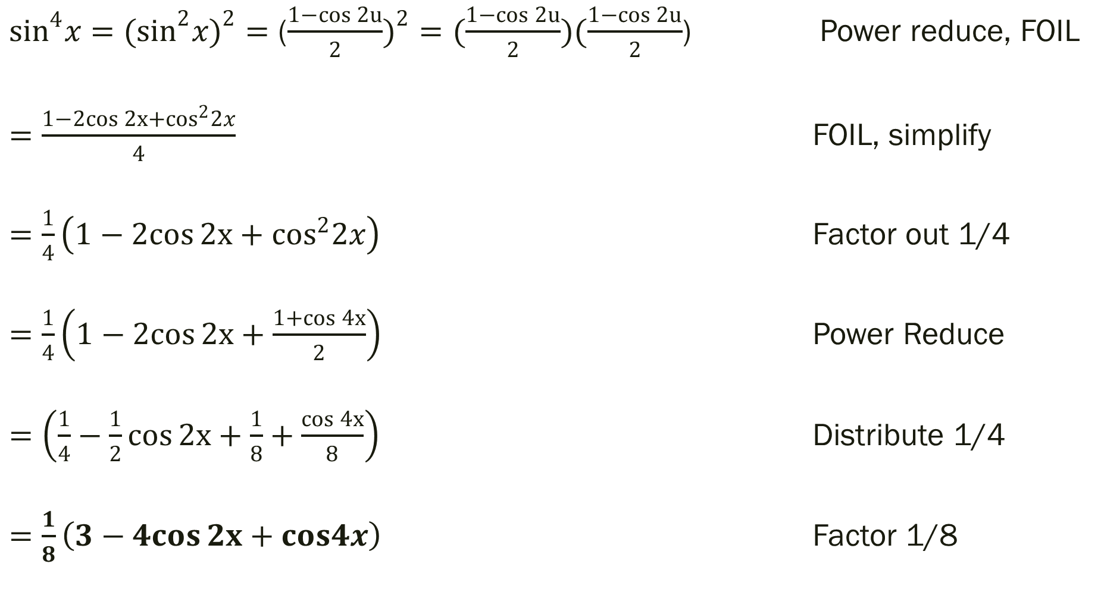
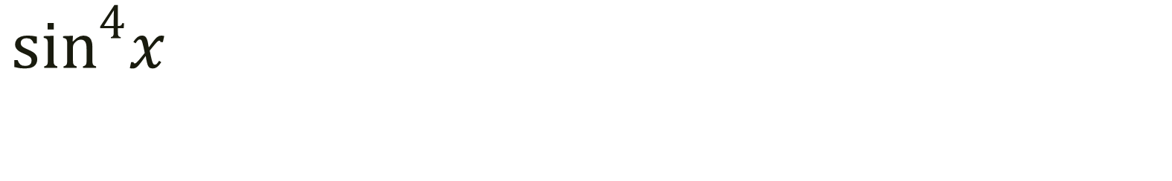
$\sin^{4}x$
$\sin^{4}x={(sin}^{2}x)^{2}=$ ($\frac{1−\cos{2u}}{2})^{2}=(\frac{1−\cos{2u}}{2})(\frac{1−\cos{2u}}{2}$) Power reduce, FOIL
$=\frac{1−2cos{2x}+\cos^{2}2x}{4}$ FOIL, simplify
$=\frac{1}{4}\left(1−2cos{2x}+\cos^{2}2x\right)$ Factor out 1/4
$=\frac{1}{4}\left(1−2cos{2x}+\frac{1+\cos{4x}}{2}\right)$ Power Reduce
$=\left(\frac{1}{4}−\frac{1}{2}cos{2x}+\frac{1}{8}+\frac{\cos{4x}}{8}\right)$ Distribute 1/4
$=\frac{1}{8}\left(3−4cos{2x}+cos4x\right)$ Factor 1/8

Slide 11
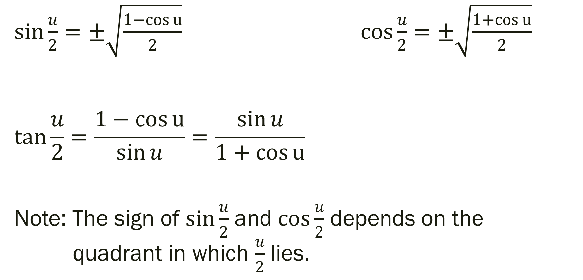
Half-Angle Formulas [page 408]
$\sin{\frac{u}{2}}=±\sqrt{\frac{1−\cos{u}}{2}}$ $\cos{\frac{u}{2}}=±\sqrt{\frac{1+\cos{u}}{2}}$
$$\tan{\frac{u}{2}}=\frac{1−\cos{u}}{\sin{u}}=\frac{\sin{u}}{1+\cos{u}}$$
Note: The sign of $\sin{\frac{u}{2}}$ and $\cos{\frac{u}{2}}$ depends on the quadrant in which $\frac{u}{2}$ lies.

Slide 12

Example 3 (Half-Angle Formulas)
Find the exact value of $\sin{105°}$
$Note:105 is half of 210$

Slide 13
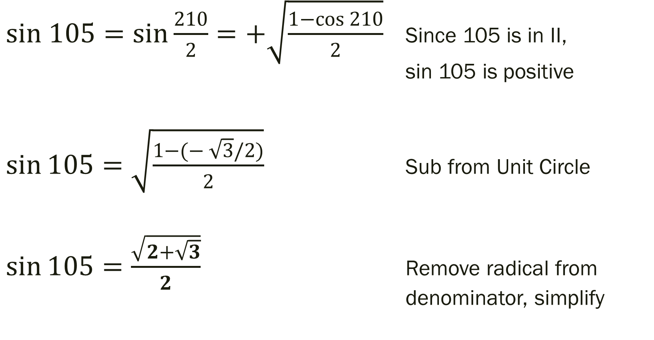

Find the exact value of $\sin{105°}$
$sin 105=sin{\frac{210}{2}}=+\sqrt{\frac{1−\cos{210}}{2}}$ Since 105 is in II, sin 105 is positive
$\sin{105}=\sqrt{\frac{1−(−\sqrt{3}{/2)}}{2}}$ Sub from Unit Circle
$\sin{105}=\frac{\sqrt{2+\sqrt{3}}}{2}$ Remove radical from denominator, simplify

Slide 14

Product-To-Sum Formulas [page 409]
$\sin{u\sin{v}}=\frac{1}{2}[\cos\left(u−v\right)−\cos{(u+v)]}$
$\cos{u\cos{v}}=\frac{1}{2}[\cos\left(u−v\right)+\cos{(u+v)]}$
$$\sin{u\cos{v}}=\frac{1}{2}[\sin\left(u+v\right)+\sin{(u−v)]}$$
$$\cos{u\sin{v}}=\frac{1}{2}[\sin\left(u+v\right)−\sin{(u−v)]}$$

Slide 15

Example 4 (Product-To-Sum Formulas)
Rewrite the product $\cos{6x}\sin{3x}$

Slide 16
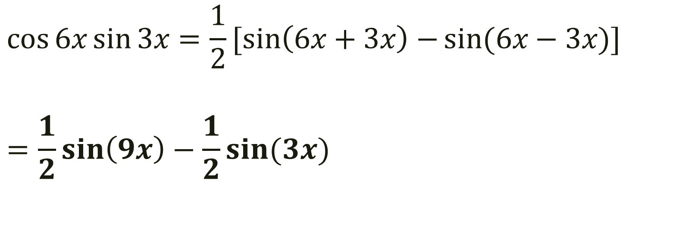

Rewrite the product $\cos{6x}\sin{3x}$
$$\cos{6x}\sin{3x}=\frac{1}{2}[\sin\left(6x+3x\right)−\sin{(6x−3x)]}$$
$$=\frac{1}{2}\sin\left(9x\right)−\frac{1}{2}\sin{(3x)}$$

Slide 17
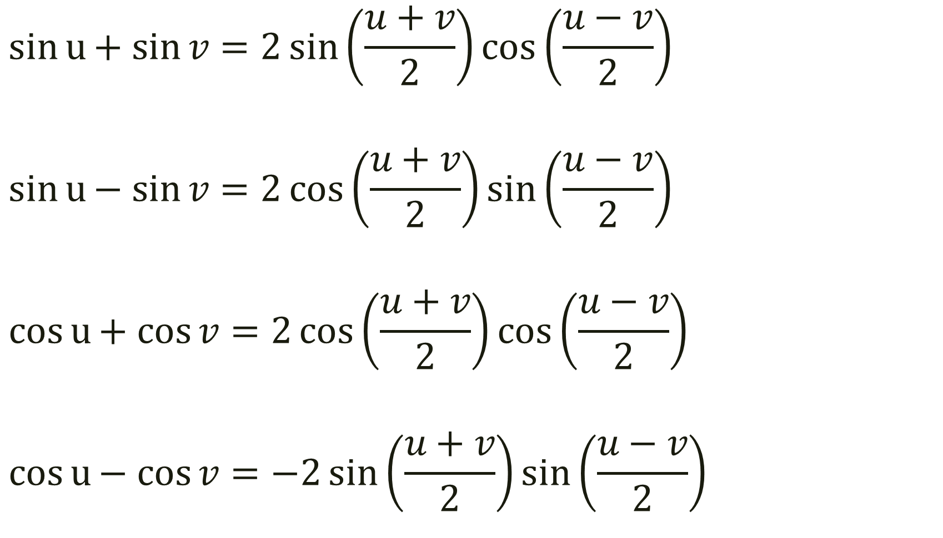
Sum-To-Product Formulas [page 410]
$$\sin{u+ sin{v}}=2\sin\left(\frac{u+v}{2}\right)\cos\left(\frac{u−v}{2}\right)$$
$$\sin{u− sin{v}}=2\cos\left(\frac{u+v}{2}\right)\sin\left(\frac{u−v}{2}\right)$$
$$\cos{u+ cos{v}}=2\cos\left(\frac{u+v}{2}\right)\cos\left(\frac{u−v}{2}\right)$$
$$\cos{u− cos{v}}=−2\sin\left(\frac{u+v}{2}\right)\sin\left(\frac{u−v}{2}\right)$$

Slide 18

Example 5 (Sum-To-Product Formulas)
Find the exact value of $\cos{195°}+cos{105°}$

Slide 19
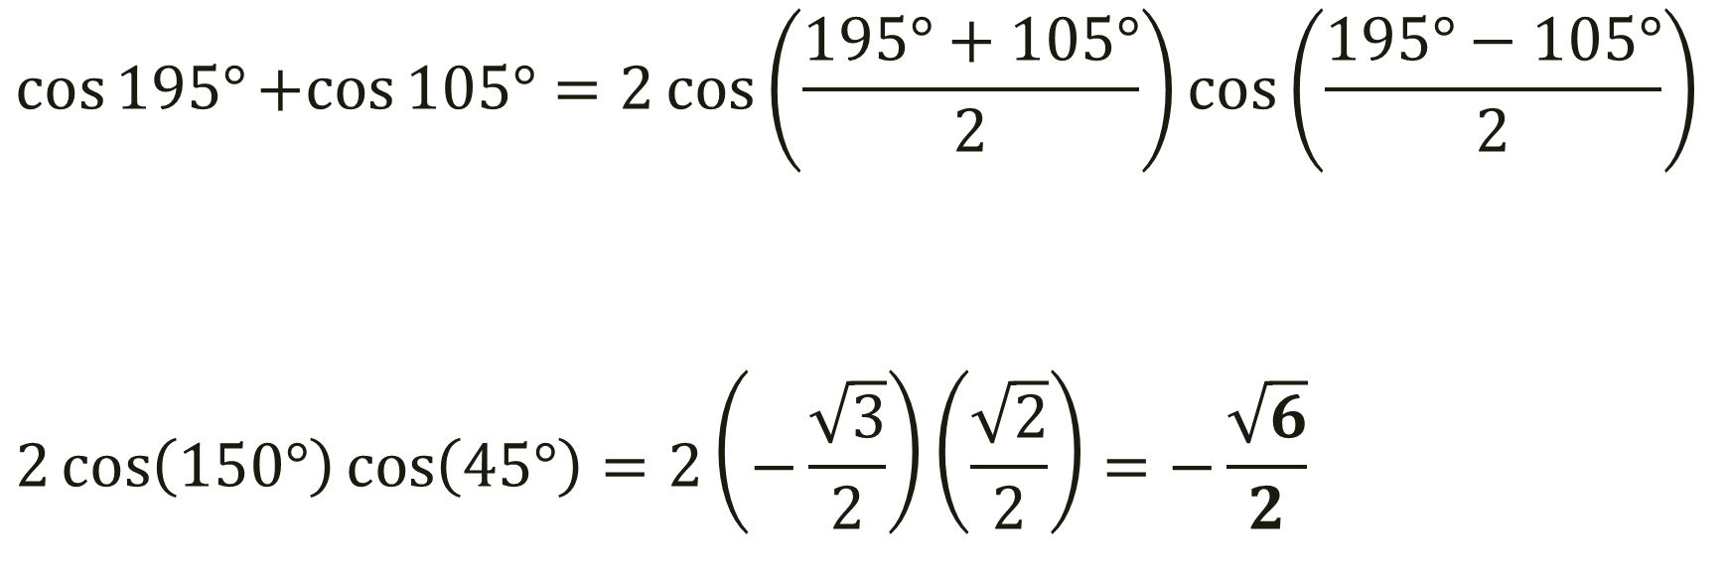
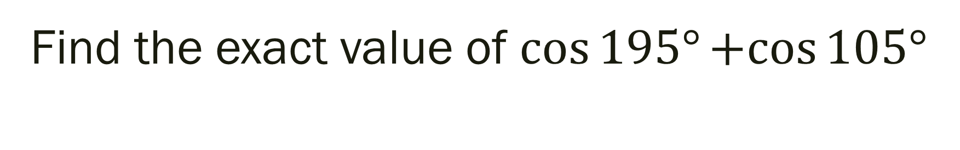
Find the exact value of $\cos{195°}+cos{105°}$
$$\cos{195°}+cos{105°}=2\cos\left(\frac{195°+105°}{2}\right)\cos\left(\frac{195°−105°}{2}\right)$$
$$2\cos\left(150°\right)\cos\left(45°\right)=2\left(−\frac{\sqrt{3}}{2}\right)\left(\frac{\sqrt{2}}{2}\right)=−\frac{\sqrt{6}}{2}$$

Slide 20
For Next Time
Pg 413 #11-21, 29-31, 43-49, 53-55, 59-61, 81-83, 91-93, 99, 107-109, 111-113
(All Odd)

